Slide 1

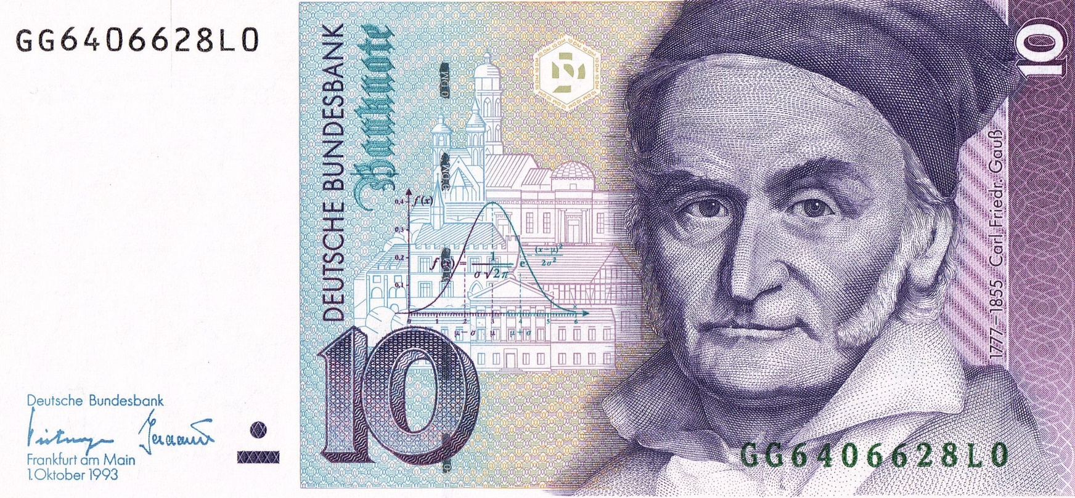
https://www.uni-goettingen.de/en/48115.html
*theory*.ppt
*theory*.ppt
For the purpose of teaching: § 60a UrhG.
https://dejure.org/gesetze/UrhG/51.html
This page; all pages, all chapters of UNPLAB
UNPLAB-h²_GxE_Ch4[Sel.Intensity]
GxE and h²; Selection Intensity
1

Slide 2
Sequential Number: #16
UNPLAB-h²_GxE_Ch4[Sel.Intensity]
Unless I explicitly state otherwise, images and cartoons are created using ChatGPT.
You may use this material free of charge under the terms of the CC BY license. This requires that you provide appropriate attribution to the author: W. Link, University of Goettingen, Germany.
In a few cases, individual images, photographs, or similar material may be subject to a more restrictive Creative Commons license. Where this applies, it is explicitly indicated, and you must comply with the stated license terms for those items.
Please check the license information carefully before reuse. Responsibility for complying with the applicable license terms rests entirely with you.
2

Slide 3
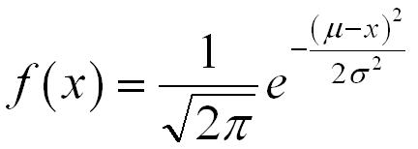
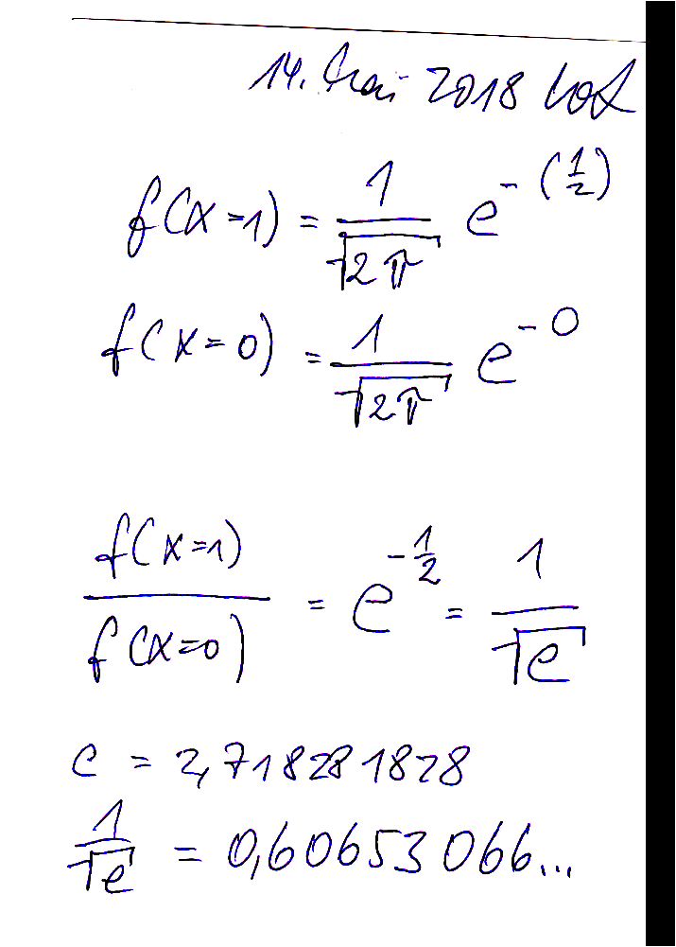
You already know: Population Genetics. Linear Model of phenotypic data. ANOVA. Broad sense heritability. Yield Stability.
Keywords of this chapter: Normal Distribution. Point of Inflexion, Standard Deviation. Central Limit Theorem.
Carl F. Gauss (1777 – 1855). ’Point of Truncation’ vs. ’Selection Intensity i’.
Selection intensity i with N= ∞ and with N<∞
Algebra as introduced in this chapter: Selection intensity ‚i‘: i = z_{α} / α
3

Slide 4
0.4
0.3
Relative Frequency of Occurrence
0.2
0.1
0.0
-4
-3
-2
-1

Slide 5
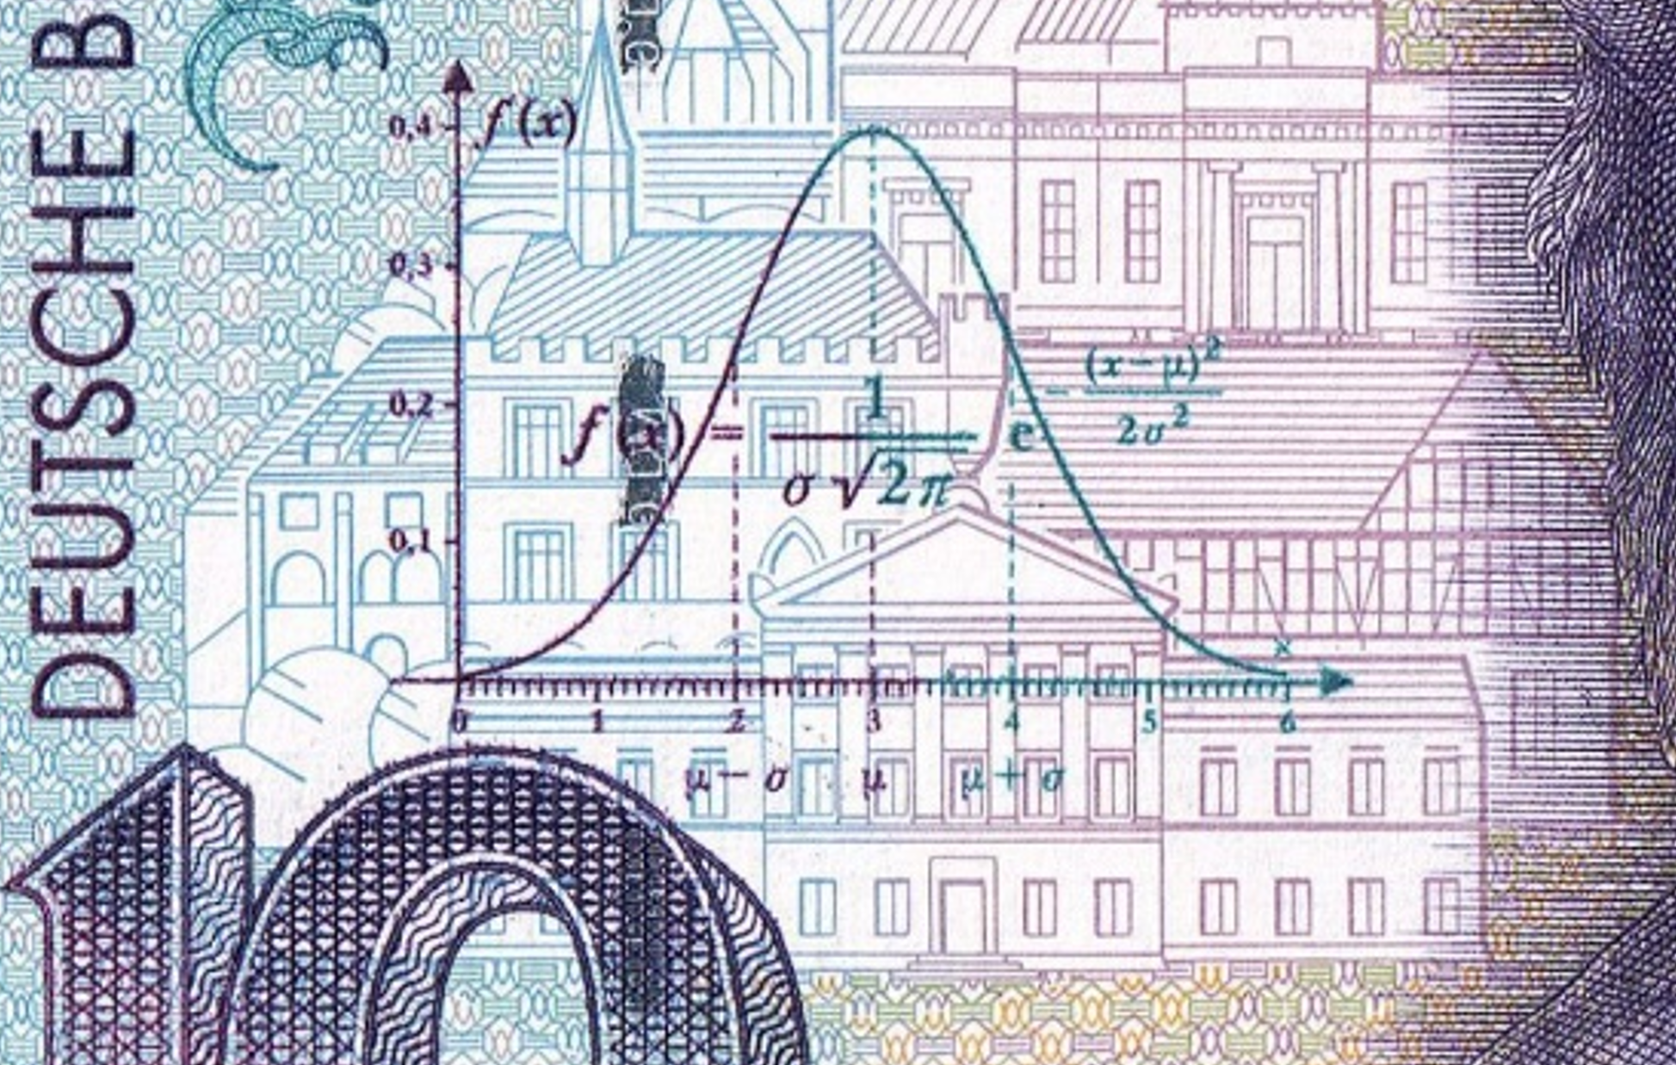
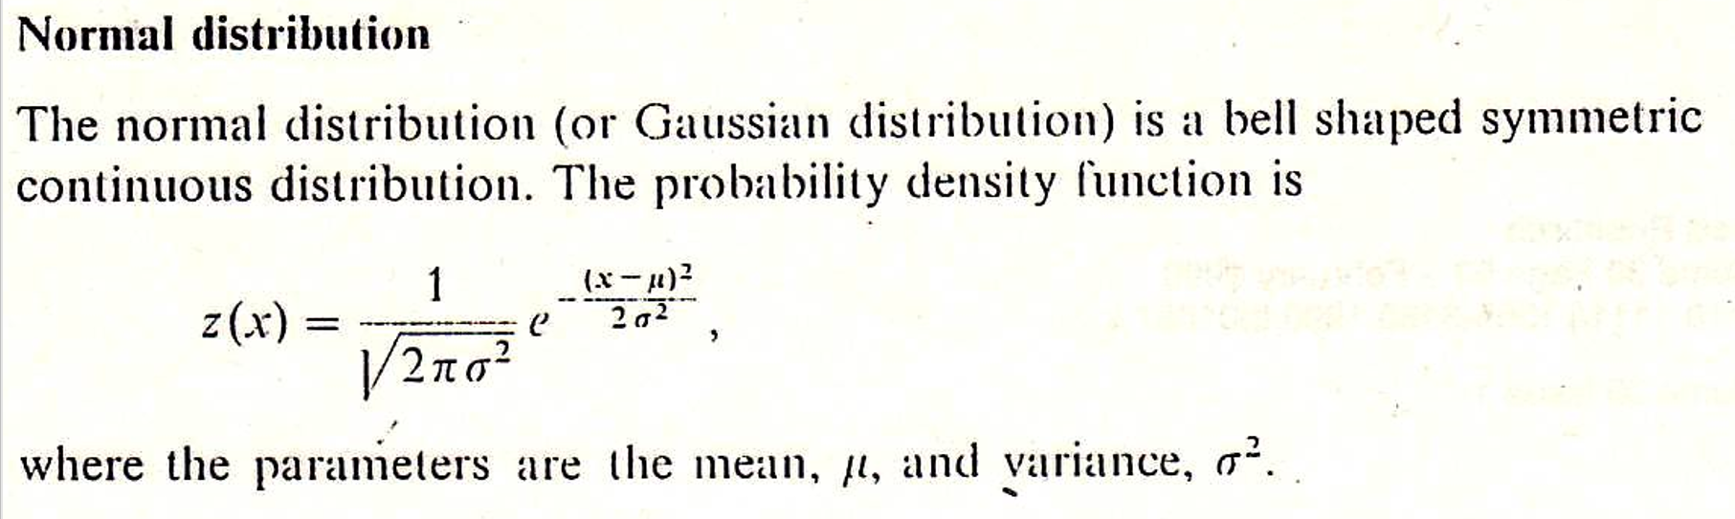
5
The 10 Deutsche Mark note shows not only the Normal Distribu-tion as developed by C.F. Gauss at Göttingen, but as well historical buildings of Göttingen. The University, the historical astronomical observatory, the old Town Hall, the main Church Towers.

Slide 6

Der Zentrale Grenzwertsatz besagt, dass sich die Verteilung der Stichprobenmittelwerte oder Stichprobensummen vieler Stichproben mit wachsendem Stichprobenumfang einer Normalverteilung annähert. Es ist egal, welchen Verteilungen (binomial, Poisson usw.) die einzelnen Messwerte in der Grundgesamtheit folgen.
The Central Limit Theorem says: The distribution of sample means or sample totals of a high number of samples approaches a Normal Distribution as the number of samples increases. Regardless of whether the basic pool of data has a Normal, Poisson, Binomial, or any other distribution: The sampling distribution of the mean-of-data will be the Normal Distribution. The Central Limit Theorem was first established within the framework of binomial distribution by Moivre, Abraham de (1733).
The distances reached by the balls that are served (thrown) by a tennis ball serving machine vary,
depending on random effects of wind, exact weight of ball, other minor factors; and the sum of the
many subtle impacts causes a more or less normal distribution of the distances reached (even
though these factors need not be normally distributed themselves).
The body height or body weight et cetera of all children who are in a schoolyard tends to be normally distributed, because not only factors such as boys vs. girls or young vs. elder but many other factors join their impacts; the outcome can be thought of as the summed impact of very many influences.
For polygenic traits, the genetic values and the phenotypic values of genotypes of a population tend to follow a normal distribution, for the same reasoning: Very many segregating loci, 2 or more alleles per locus, varying effect sizes of genes and interactions among genes, environmental impact and interactions with genes, et cetera ...
6

Slide 7
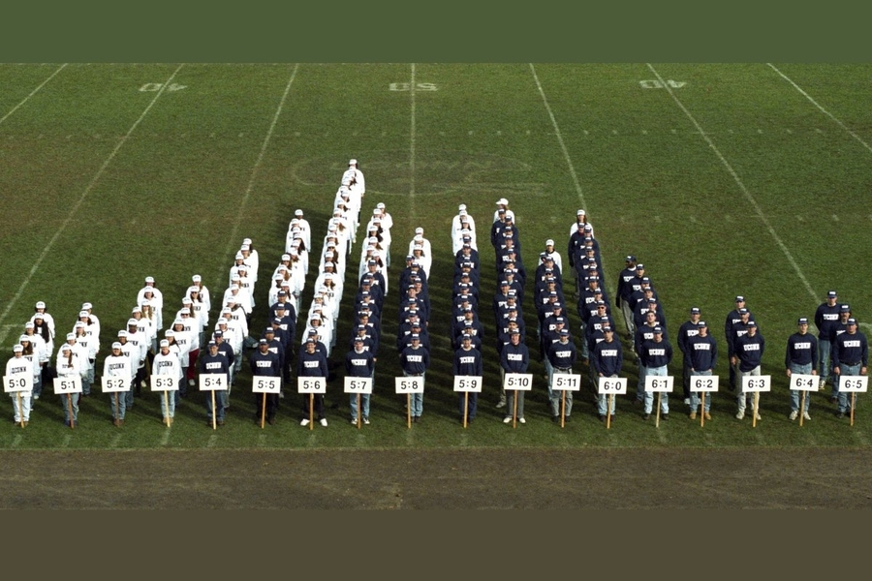
The Central Limit Theorem states this empirically long and completely convincing statement: The distribution of data which is the result of a high number of complex influences tends to follow the Normal Distribution. Body height is for sure the result of complex genetic, physiological, environmental and so on impacts and of a high number of complex interactions between all-of-this. Trivial: Most persons are more or less ‚normal‘, hence, near to the general mean. Persons more distant from the mean are less frequent.
From Connecticut Stat University in 1996. The means ± standard deviations (inches): Males 70.1 ± 3.0; Females 64.8 ± 2.7; Combined 67.6 ± 4.0. Photo © Linda Straus Baugh. DOI 10.1007/978-3-662-58172-8_12 (with curtesy from Linda Strausbaugh and Peter Morenus, Connecticut; January 5 2026)
7

Slide 8
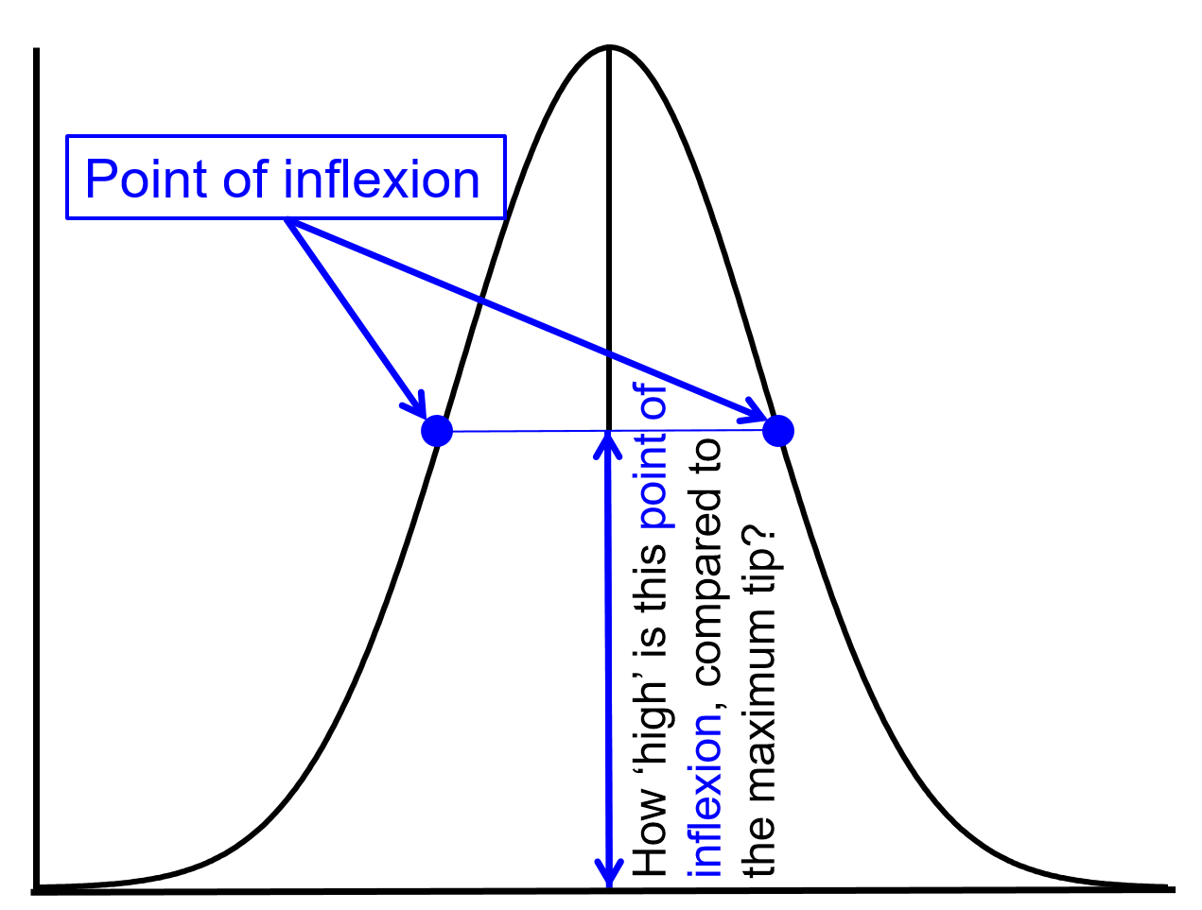
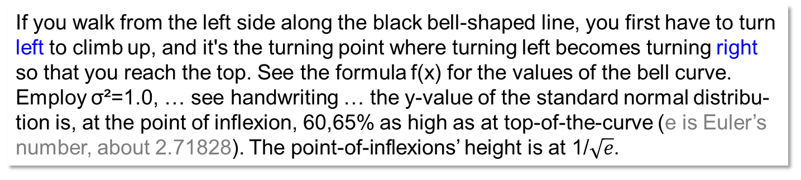
I was curious: where is this magical “turning point”?
If you walk from the left side along the black bell-shaped line, you first have to turn left to climb up, and it's the turning point where turning left becomes turning right so that you reach the top. See the formula f(x) for the values of the bell curve. Employ σ²=1.0, … see handwriting … the y-value of the standard normal distribu-tion is, at the point of inflexion, 60,65% as high as at top-of-the-curve (e is Euler’s number, about 2.71828). The point-of-inflexions’ height is at 1/$\sqrt{e}$.
The y-value of the two points-of inflexion are not at a simple height such as half-of maximum or 2/3-of maximum.
Things are seemingly a slightly bit more complicated than that.
Alas.
8

Slide 9
Next question. The slimmer, the taller. Obviously. What is the relationship here?
9

Slide 10
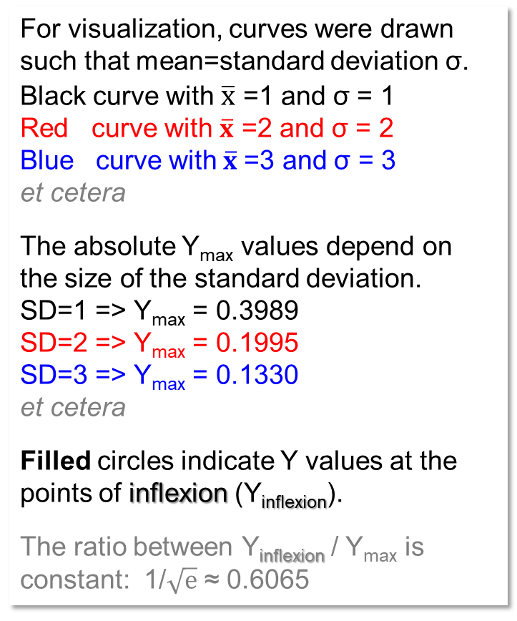
Relationship between Y_{max} and Standard Deviation σ: Y_{max} ∙ σ = 1/(2π)^{0.5}
σ =1.0 => Y_{max} = 0.3989 Y_{max} = 1/[σ ∙(2π)^{0.5}]
σ=2.0 => Y_{max} = 0.1995
0.4
SD=1.0
SD=2.0
For visualization, curves were drawn such that mean=standard deviation σ.
Black curve with $\overline{x}$ =1 and σ = 1
Red curve with $\overline{x}$ =2 and σ = 2
Blue curve with$\overline{x}$ =3 and σ = 3
et cetera
The absolute Y_{max} values depend on the size of the standard deviation.
SD=1 => Y_{max} = 0.3989
SD=2 => Y_{max} = 0.1995
SD=3 => Y_{max} = 0.1330
et cetera
Filled circles indicate Y values at the points of inflexion (Y_{inflexion}).
The ratio between Y_{inflexion} / Y_{max} is constant: 1/$\sqrt{e}$ ≈ 0.6065
SD=3.0
100%
SD=4.0
0.3
SD=5.0
Point of infl.
SD=6.0
0.2
60.65%
0.1
0.0
-6
-4
-2
0
1
2
3
4
5
6
8
10
12
14
10

Slide 11

Ten Deutsche Mark, showing Carl F. Gauss (1777 – 1855) who worked and taught at Göttingen; and e.g. showing shape and equation of the Normal Distribution.
0.4
100%
0.3
0.2
60.65%
0.1
0.0
-6
-4
-2
0
1
2
3
4
5
6
8
10
12
14
11

Slide 12
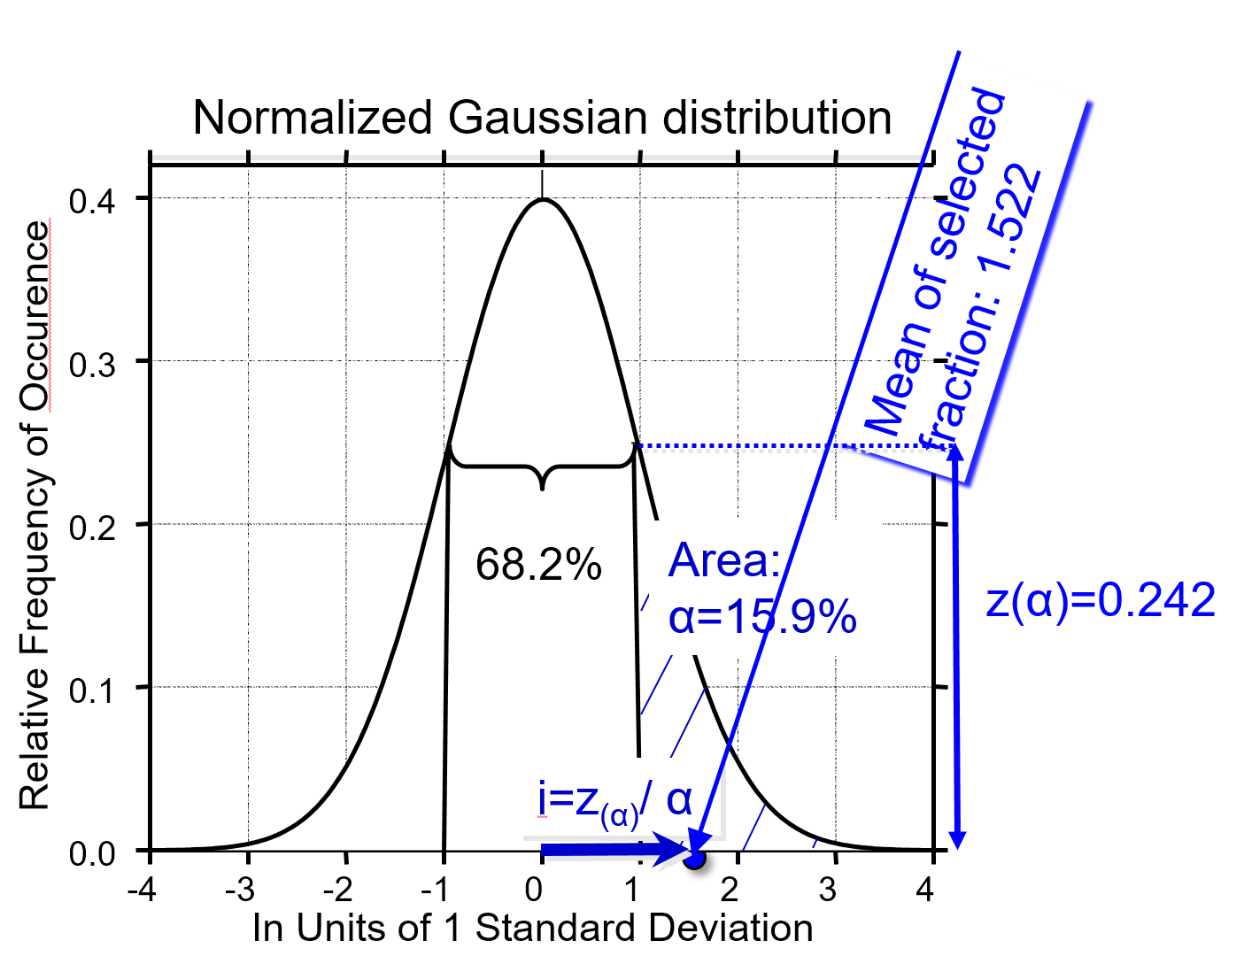
We select! Here, we select the ones that have high values. There is a threshold.
All those which are higher-than-threshold are ‚taken‘.
Trait expression follow the Normal Distribution (‚quantitative‘ trait, con-tinuously distributed). Not like e.g. presence-absence of awns. Mean is zero, variance is 1.0, meaning: Normalized (standardized) values.
Of course, you can always transform your data so that they display N(0;1) features.
You deduce the general mean from each data point to have effects instead of values.
You calculate the variance in your data and then divide each effect by the standard deviation.
This will by the way not change the correlation of your data to other data.
Threshold
i=z(α)/α
1
12

Slide 13
How many steps of step-length 1.0 do you walk on the X-axis from µ of the distribution (here µ=0) to reach the mean ● of the Selected Fraction (here at 1.522)?
You walk 1.522 steps! That number tells the so-called selection intensity: i=1.522 (usually designated with the small letter i).
This should illustrate what Selection Intensity means.
Mind the difference between
>Strictness* of selection (α)
>Intensitiy of selection (i)
Strictness: You tell how strict you are,
how harsh you select. You may take 30% superior ones, rather mild selection, or only 1% best ones, rather rigorous selection.
Intensity: You employ the normal distribution and find i; as shown here.
Tip is at 0.3989
Threshold
0
1
13
*severity, rigidity, harshness of selection.

Slide 14
How many steps of step-length 1.0 do you walk on the X-axis from µ of the distribution (here µ=0) to reach the new mean value which is the mean of the selected fraction (here at 1.522)? You walk 1.522 steps! That number tells the so-called selection intensity: i=1.522.
Mean ● of selected fraction α; this mean is slightly larger than the point of truncation (threshold). So-called selection intensity ‚i‘: i = z_{α}/α; here: i = 0.242/0.159 = 1.522
The mean of the selection fraction of candidates is, of course, higher than the threshold; but not very much higher, because most selected ones are barely higher than threshold: Very high ones are very rare. If the threshold is x=1.0, then the shape of the normal distri-bution (σ²=σ=1) tells that the mean of the selected ones is expected at x=1.522 (α=15.9% are expected to surpass that threshold); 1.0-0.682)/2=0.159; α=15.9%.
If selection was weaker, for instance the better 50% were selected, then i=0.798. i=0.3989/0.500=0.798.
If you are given the task of creating a new material in one selection step, and that new germplasm must be 4 SD better than the old material, then ... Mission Impos-sible. For i=4 you need to be stricter than ‘best of 10.000’, stricter than α=0.01%. You need more than 10.000 evaluated candidates … usually not doable (and here we neglected that h²<1, mind you).
Normalized Gaussian distribution
0.4
Mean of selected
fraction: 1.522
0.3
Relative Frequency of Occurence
0.2
0.1
0.0
-4
-3
-2
-1
14

Slide 15

0.4
0.3
Relative Frequency of Occurence
0.2
0.1
0.0
-4
-3
-2
-1

Slide 16

0.4
0.3
Relative Frequency of Occurence
0.2
0.1
0.0
-4
-3
-2
-1

Slide 17
0.4
0.3
Relative frequency of occurrence
0.2
0.1
0.0
-4
-3
-2
-1

Slide 18
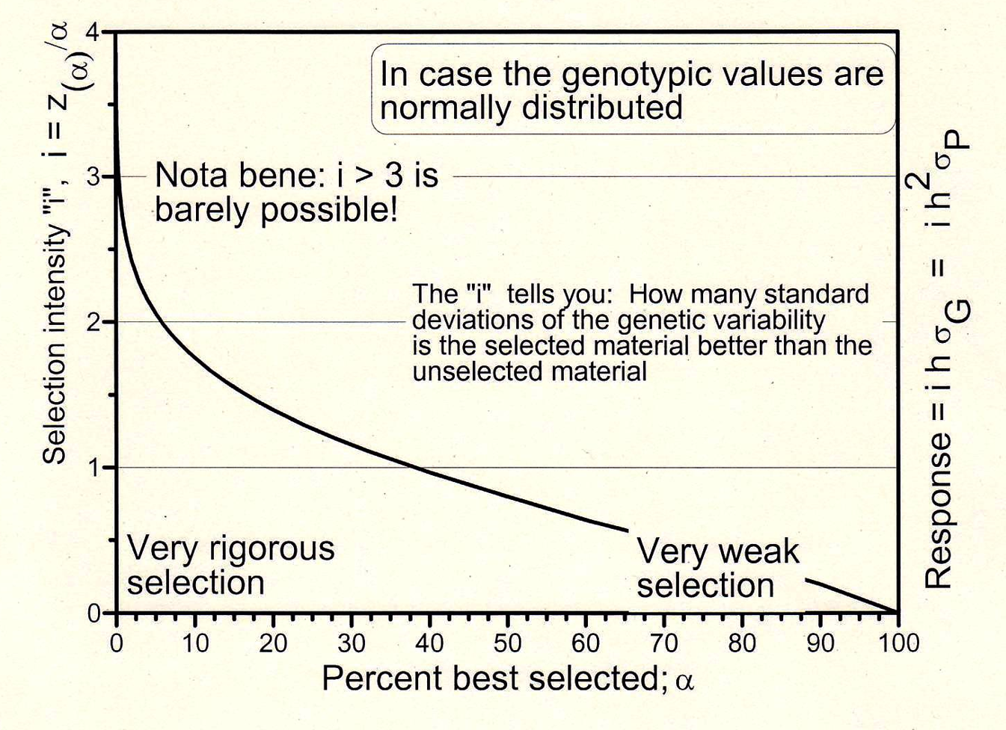
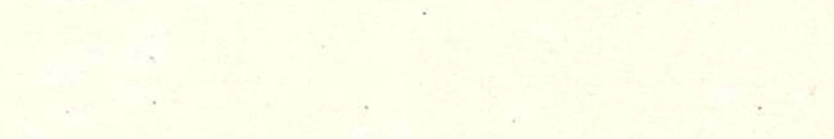
See the connection between strictness (aka rigor; α) of selection (such as taking α=50% best or only 10% or 2% best ...) and Selection Intensity i. 50% translates into i=0.798. The right-hand diagram resolves the are of strict selection, focus is on 10% - 2%.
.. this connection applies if data is normally distributed; applies the better, the nearer data distribution is to Normal.
0.798
50
18

Slide 19
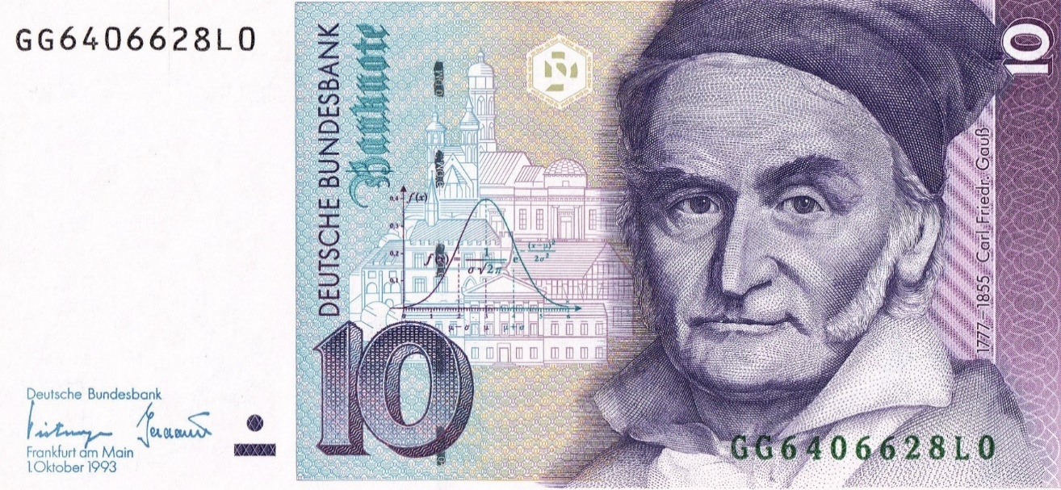
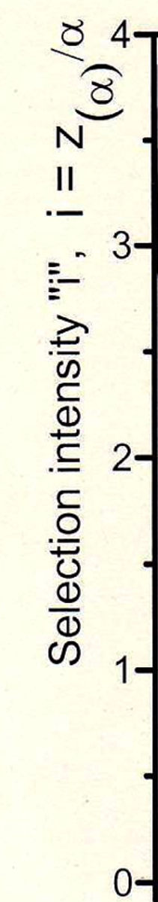
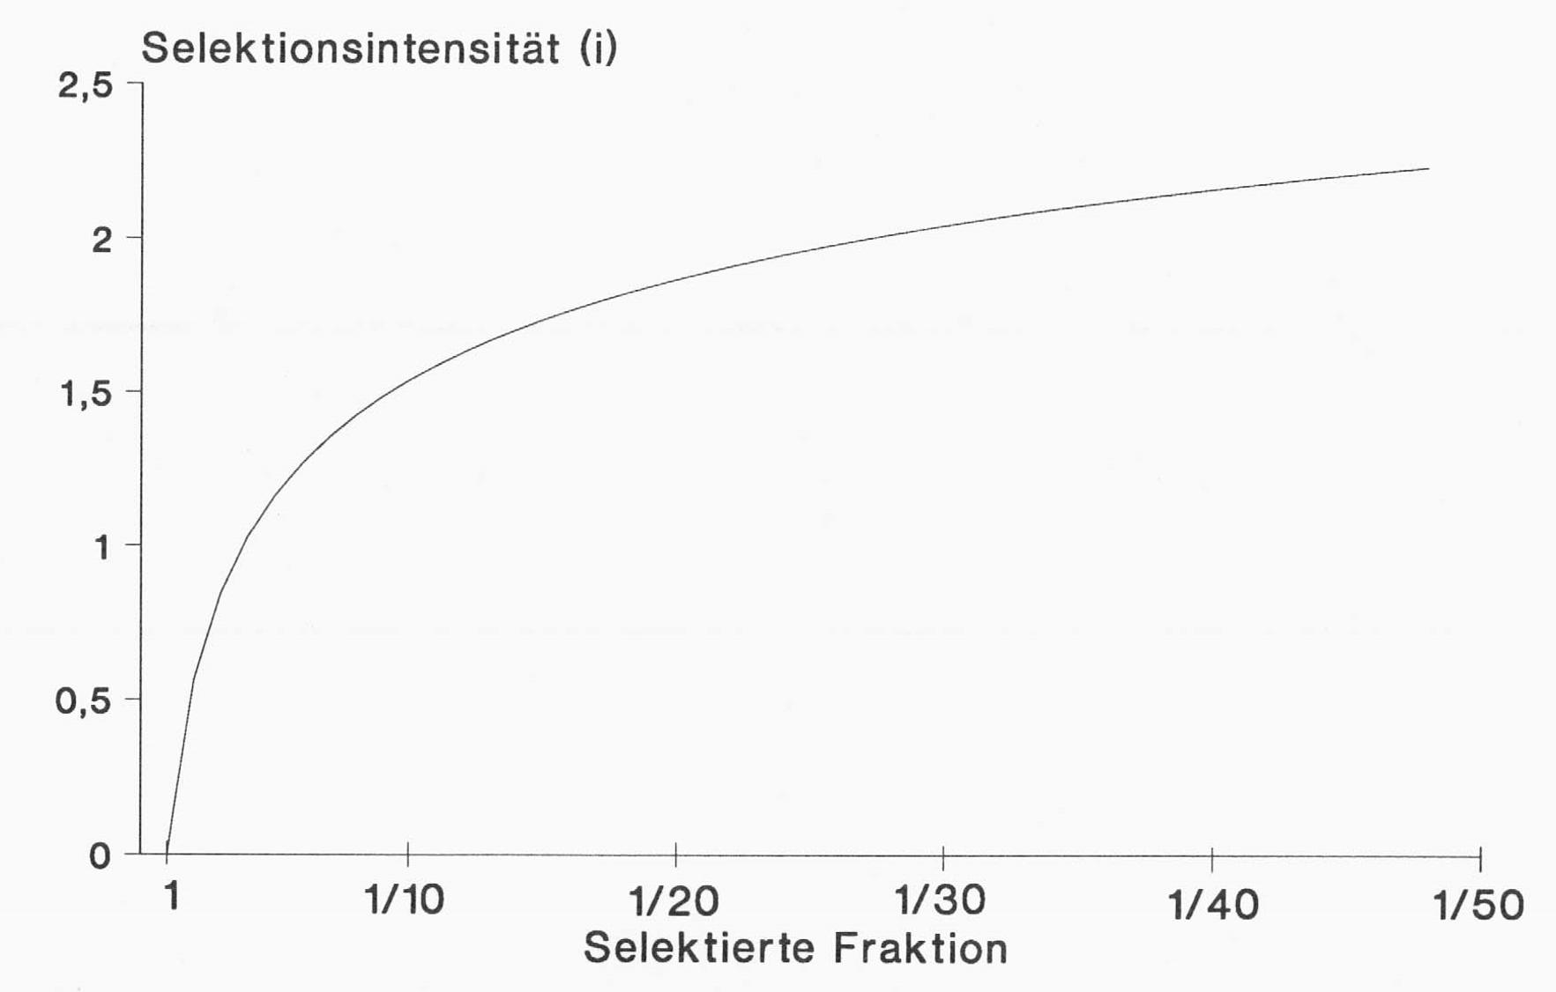

See the connection between strictness (aka rigor; α) of selection (such as taking α=50% best or only 10% or 2% best ...) and Selection Intensity i. 50% translates into i=0.798. The right-hand diagram resolves the are of strict selection, focus is on 10% - 2%.
.. this connection applies if data is normally distributed; applies the better, the nearer data distribution is to Normal.
0.798
100
10
5.0
3.$\overline{3}$
2.5
2.0
50
Selected fraction; Percent best selected; α
19

Slide 20
So far, we implicitly assumed: Number of candidates to select from is N=∞.
Having assumed Normal Distribution, this is an additional ‚harsh‘ assumption.
And this one is, of course, never true.
Breeders may have 100 or 1000 or maybe even 2000 candidates to select from, but never such as 100.000 or more (well …. ‚never‘ ?).
Let us see what happens if N < ∞ (but still data follows Normal Distribution).
20

Slide 21
We inspect the setting of data which precisely follow the Normal Distribution, yet, number of candidates to select from is limited. Here, as example, N=38 and N=2.
N=38 as ‘relatively many’; N=2 as few.
Values for really large numbers do not exist in the Beyer-tables. Nevertheless, what I show is sufficient for to illustrate the principle.
Instead of simulating, we employ so-called Order Statistics. In Beyer (1966) we find the expected value of the highest, second-highest, third-highest et cetera value of e.g. N=38 values, randomly taken from a perfect N(0,1) Normal Distribution.
The highest and the lowest in a sample of N=38 is expected at +2.14009 and -2.14009 (given µ=0 and SD=1.0); etc.
Beyer, W.H. (ed.), 1966: Handbook of Tables for Probability and Statistics. 2nd edition. The Chemical Rubber Co., Cleveland Ohio. Page 331.
21

Slide 22
We inspect the setting of data which precisely follow the Normal Distribution, yet, number of candidates to select from is limited. Here, as example, N=38 and N=2.
Data are placed exactly as expected, as average of endless many replicated samp-lings with N=38.
I do like these Order Statistics tables.
The expected value of the highest out of N=38 is 2.14009
22

Slide 23
We inspect the setting of data which precisely follow the Normal Distribution, yet, number of candidates to select from is limited. Here, as example, N=38 and N=2.
We select!
Strictness of selection: We choose α = 50% (we take the better half).
We determine the mean value of this better half (mean of the selected fraction).
See it indicated by arrow.
That mean value is at x=0.780.
I'll give it away, for N=∞ instead of N=38, that would be at x=0.798 instead of at x=0.780 ...
Mean of higher 50%
Mean =0.780
23

Slide 24
We now re-organize. The total of N=38 was randomly split into 19 pairs-of-two. Take N=38 as ‘relatively many’; N=2 is few; and we have 19 random repetitions of this split.
● 38 candidates placed according to Order Statistics
○ 19 random pairs of two
Mean of higher 50%
We still can select the better 50%, now this is
“the better-out-of-two”. Those N=2 that make a pair are on same vertical position, 19 pairs. The pair number 1 (the ‘uppermost’ pair) is emphasized and highlighted by the connection line.
It is an extreme limitation in number of candidates, N=2; we select one of the two, the better one (α=50%). Our α was kept, though!
Just N went (from N=38) down to N=2.
We took, indeed, a very extreme case, but the enlightenment from it will help us to well anticipate this effect in more realistic, less extreme settings.
1
2
3
4
5
6
7
8
9
10
11
12
13
14
15
16
17
18
19
Mean =0.780
24

Slide 25
We now determine the better of the two, 19 times (four pairs highlighted now).
We see that in five of the 19 pairs, the better-of-two is not part of those 50% which are – honestly – the better 50%. If we take 19 super-small breeding programs (each with only 2 candidates), and compared this to a ‘larger’ breeding program with 38 candidates ...
… then several of the small programs happen to work with candidates that were both inferior (one such pair framed red).
This bad luck is not counterbalanced by those programs who worked with two superior candi-dates. A superior pair spoils the less-good of its two, because that one still belongs to the better half yet is dis-regarded when selecting.
Summing across the 19 programs, five of the 19 ‚honestly‘ superior candidates are missing and substituted by five honestly inferior ones.
● 38 candidates placed according to Order Statistics
○ 19 random pairs of two
The higher one of two
Mean of higher 50%
1
2
3
4
5
6
7
8
9
10
11
12
13
14
15
16
17
18
19
framed red
25

Slide 26
We now determine the better of the two, 19 times (four pairs highlighted).
We see that in five of the 19 pairs, the better-of-two is not part of those 50% which are – honestly – the better 50%. If we take 19 super-small breeding programs (each with only 2 candidates), and compared this to a ‘larger’ breeding program with 38 candidates ...
… then several of the small programs happen to work with candidates that were both inferior (one such pair framed red).
This bad luck is not counterbalanced by those programs who worked with two superior candi-dates. A superior pair spoils the less-good of its two, because that one still belongs to the better half yet is dis-regarded when selecting.
Summing across the 19 programs, five of the 19 ‚honestly‘ superior candidates are missing and substituted by five honestly inferior ones (framed).
● 38 candidates placed according to Order Statistics
○ 19 random pairs of two
The higher one of two
Mean of higher 50%
1
2
3
4
5
6
7
8
9
10
11
12
13
14
15
16
17
18
19
26

Slide 27
The mean of the 19 higher-out-of-two values is lower than the mean value of the honestly 50% superior ones. In less extreme cases, of course, the effect is smaller.
Small programs (few candidates) show some ran-dom impact on outcome. Take their few candidates as sample from a conceptual basic pool of N=∞. Their small sample may not well represent the ba-sic pool. In some cases, their selected candidate is very superior, in other cases quite inferior, out-come of replicate small samples varies much. On ave-rage, the expected gain with α=50% is clearly smaller that the expected gain with the same α=50% but from many candidates.
Selection intensity in case of N= ∞ and α=50% is i=0.798. This is what we usually employ.
Selection intensity in case of in case of N= 38 and α=50% is i≈0.780.
Selection intensity in case of in case of N= 2 and α=50% is i≈0.564
Here, we compared the latter two settings.
19 times the higher one of two
1
2
3
4
5
6
7
8
9
10
11
12
13
14
15
16
17
18
19
Mean of higher-out-of two
Mean of higher 50%
27

Slide 28
Follow the 19 higher-out-of-two values, see that their mean value is lower than the mean value of the honestly 50% superior ones.
● the 50% better out of N=38
19 times the higher one of two
A major message is:
Several small breeding programs will result - on average - a smaller progress (given all else same) than the program that would exist by joining their budgets, …
… I mean, by joining their candidates and data and conducting the same selection and then returning the selected ones back to the small programs (small companies) by e.g. drawing lots (by a random-fair procedure).
Breeders, however, are usually very competitive and find this type of cooperation rather difficult;
they are often hesitant to such ideas and sometimes a slightly bit stubborn.
1
2
3
4
5
6
7
8
9
10
11
12
13
14
15
16
17
18
19
Mean of higher-out-of two
Mean of higher 50%
28

Slide 29
Selection intensity for large sample size (i.e., N=∞)
Selection intensity ‘i’
29

Slide 30
Selection intensity for N<<∞ and for
very large sample size (i.e., N=∞)
https://excellenceinbreeding.org
Becker, W.A., 1984. Manual of Quantitative Genetics. 4th Edition. Academic Enterprises, Washington, USA.
30

Slide 31
0.4
0.3
Relative frequency of occurrence
0.2
0.1
0.0
-4
-3
-2
-1

Slide 32
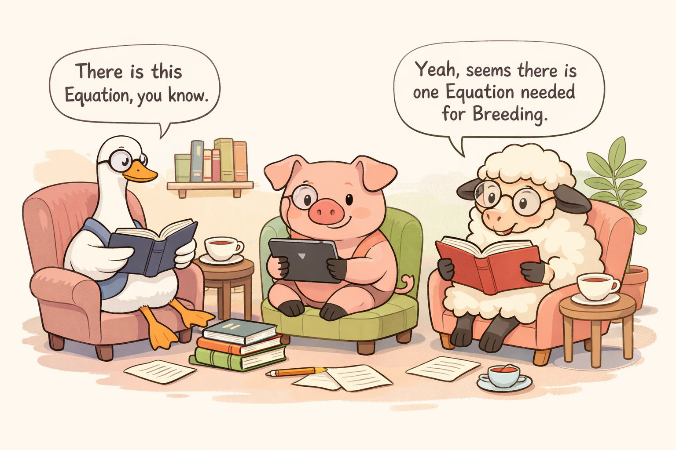
From here you may go to UNPLAB-h²_GxE_Ch-5[BreedersEquation]
32
32

